Slide 1
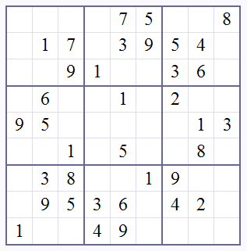
On Sinkhorn balancing and solving Sudoku
Rui Castro

Slide 2
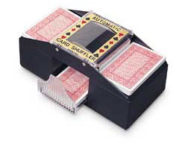
Example: Evaluating an automatic shuffler
Observations: Count the number of times the ith card ends up in the jth position
To
 | 1 | 2 | ☹ | 52
1 | 120 | 25 | ☹ | 45
2 | 50 | 100 | ☹ | 72
 |  |  |  | 
52 | 35 | 53 | ☹ | 114
Goal: Estimate the probability card in ith spot ends up in the jth position
Must satisfy some constraints (rows and columns sum to 1)
From
To
 | 1 | 2 | ☹ | 52
1 | .54 | .18 | ☹ | .23
2 | .14 | .47 | ☹ | .23
 |  |  |  | 
52 | .14 | .34 | ☹ | .50
From

Slide 3
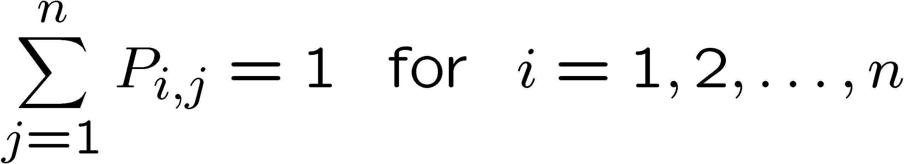
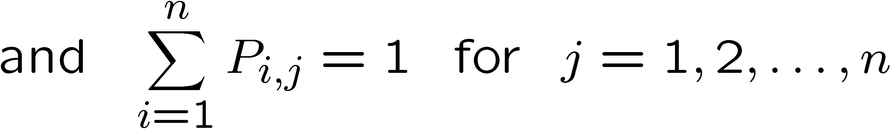
(Doubly) Stochastic Matrices
A square matrix of positive entries is stochastic if rows sum to one:
It is doubly-stochastic if both rows and columns sum to one:
Both are common in applications involving Markov Chains

Slide 4


Matrix Balancing
Given a square matrix with non-negative entries find a doubly-stochastic matrix that is close to .
Traditional (historical) applications:
- Transportation engineering
- Estimation of contingency tables
- Modeling migration patterns
- Estimating transition probabilities
A possible solution: Sinkhorn Balancing (SB)
1 | 5 | 2 | 4
2 | 1 | 1 | 3
5 | 2 | 6 | 9
2 | 4 | 6 | 1
.1 | .42 | .13 | .24
.2 | .08 | .07 | .17
.5 | .17 | .4 | .53
.2 | .33 | .4 | .06
.11 | .47 | .15 | .27
.38 | .15 | .13 | .34
.32 | .10 | .25 | .33
.20 | .34 | .40 | .06
-> Alternate between normalizing columns and rows until convergence

Slide 5

Sinkhorn Balancing (also known by other names)
Named after Richard D. Sinkhorn
Theorem (Sinkhorn, ‘64): If the entries of A are strictly positive, then the sequence of iterates produced by SB converges to
where D and E are diagonal matrices, unique to A.
Theorem (Sinkhorn & Knopp, ‘67): If A has non-negative entries then SB converges if and only if A has at least one positive diagonal, and the diagonal matrices D and E are unique if and only if A is fully indecomposable
A has Enough non-zero entries in the right locations
R. Sinkhorn, “A relationship between arbitrary positive matrices and doubly stochastic matrices,” Lin. Alg. App., 1964
R. Sinkhorn and P. Knopp, “Concerning nonnegative matrices and doubly stochastic matrices,” Pacific J. Math., 1967
Notes:
Laplace defined science as a predicting tool.

Slide 6
How Sinkhorn Balancing works
Scaling rows/columns is the same as left/right multiplication by a diagonal matrix
Sinkhorn Balancing can also be viewed as an instance of a alternate projection onto convex sets

Slide 7
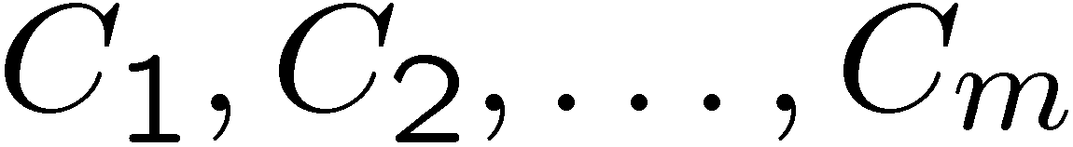

Projection Onto Convex Sets
Goal: Find point in the intersection of the convex sets
“closest” to
x₀
x₁
row stochastic
C₁
x₂
column stochastic
C₂

Slide 8
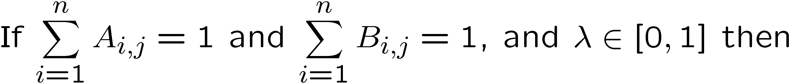
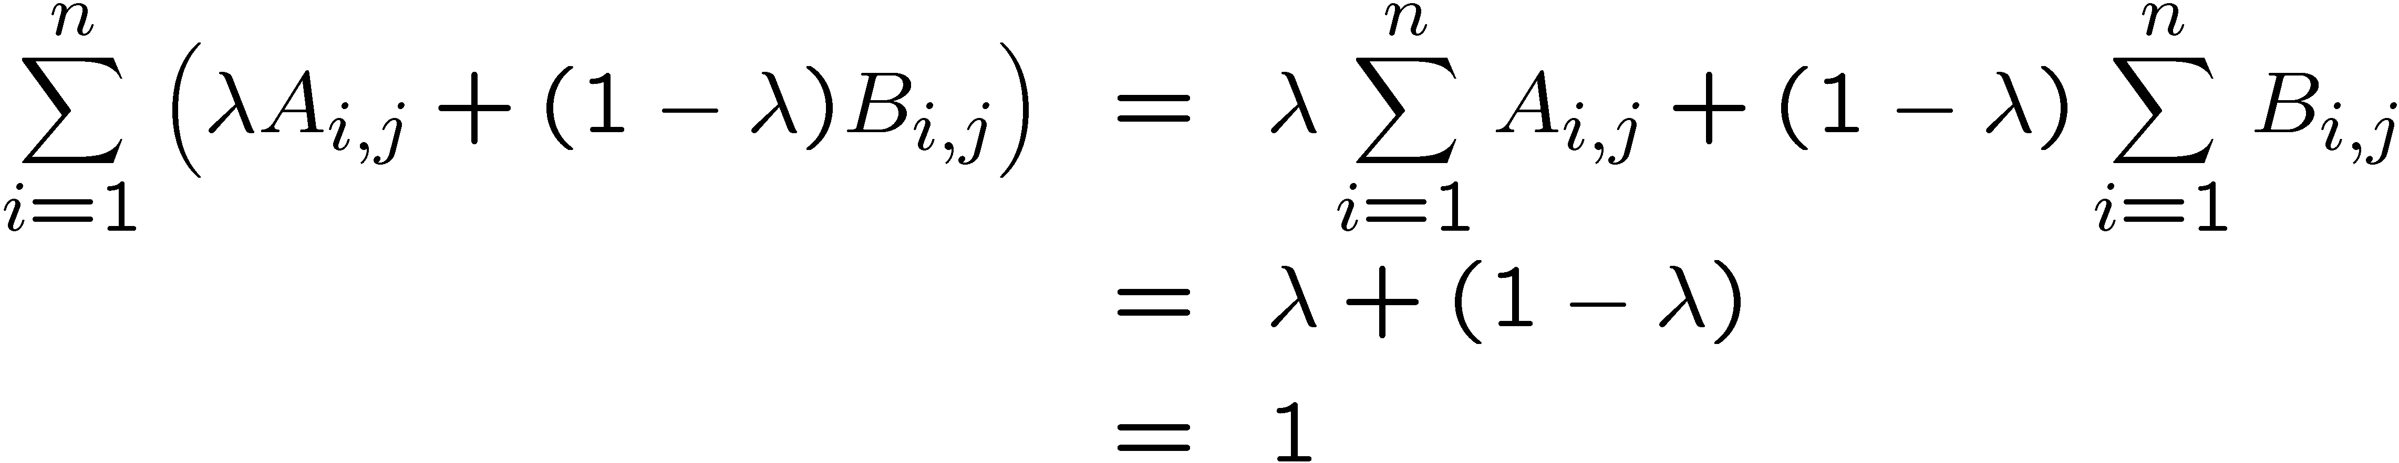
Sinkhorn and Projection onto Convex Sets
Column and row stochastic matrices for convex sets
e.g. – column stochastic:
Pictorially:
A
D₁A
C
D₁AE₁
R

Slide 9
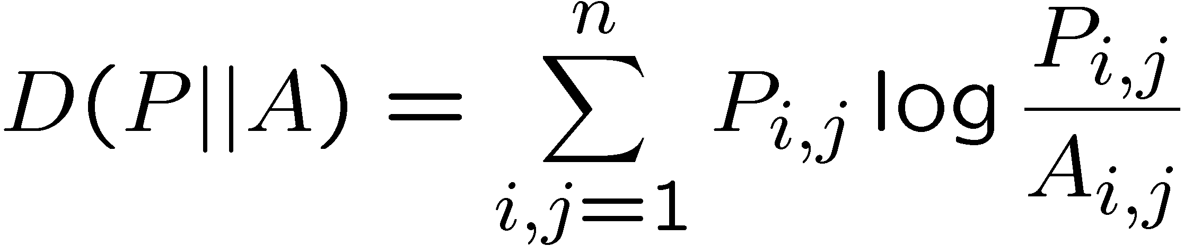
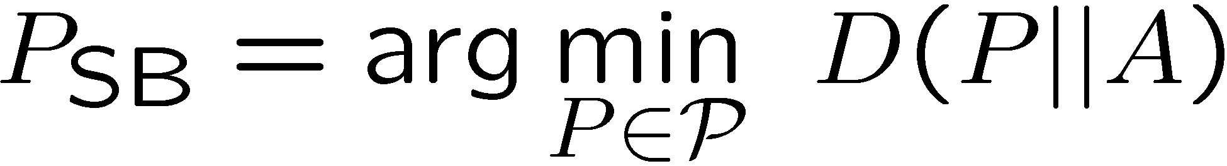
Optimality of Sinkhorn Balancing
In what sense is SB getting a “close” solution?
SB is trying to minimize the Kullback-Leibler divergence!
But what does this have to do with Sudoku???

Slide 10
Estimation and Sampling Strategies
1
9
2
7
Fill in the blanks with digits 1-9 such that each row, column and 3-by-3 square contains one of each digit
By construction every Sudoku puzzle has a unique solution
Most computer-based solvers perform a brute force search

Slide 11

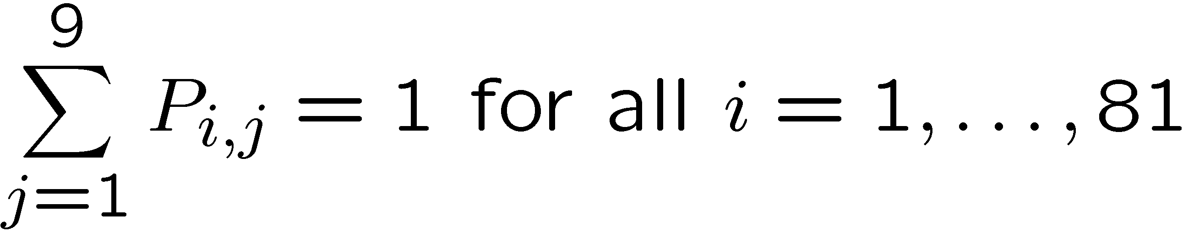
A Probabilistic Take on the Problem
Index each cell in the Sudoku grid
9 Values
1
2 …
9
1 | 10 | 19 | 28 | 37 | 46 | 55 | 64 | 73
2 | 11 | 20 | 29 | 38 | 47 | 56 | 65 | 74
3 | 12 | 21 | 30 | 39 | 48 | 57 | 66 | 75
4 | 13 | 22 | 31 | 40 | 49 | 58 | 67 | 76
5 | 14 | 23 | 32 | 41 | 50 | 59 | 68 | 77
6 | 15 | 24 | 33 | 42 | 51 | 60 | 69 | 78
7 | 16 | 25 | 34 | 43 | 52 | 61 | 70 | 79
8 | 17 | 26 | 35 | 44 | 53 | 62 | 71 | 80
9 | 18 | 27 | 36 | 45 | 54 | 63 | 72 | 81
Todd K. Moon
Utah State U
P
81 Cells
Define a 81-by-9 matrix P where P_{i,j} is the probability that cell i takes value j
probability constraints

Slide 12
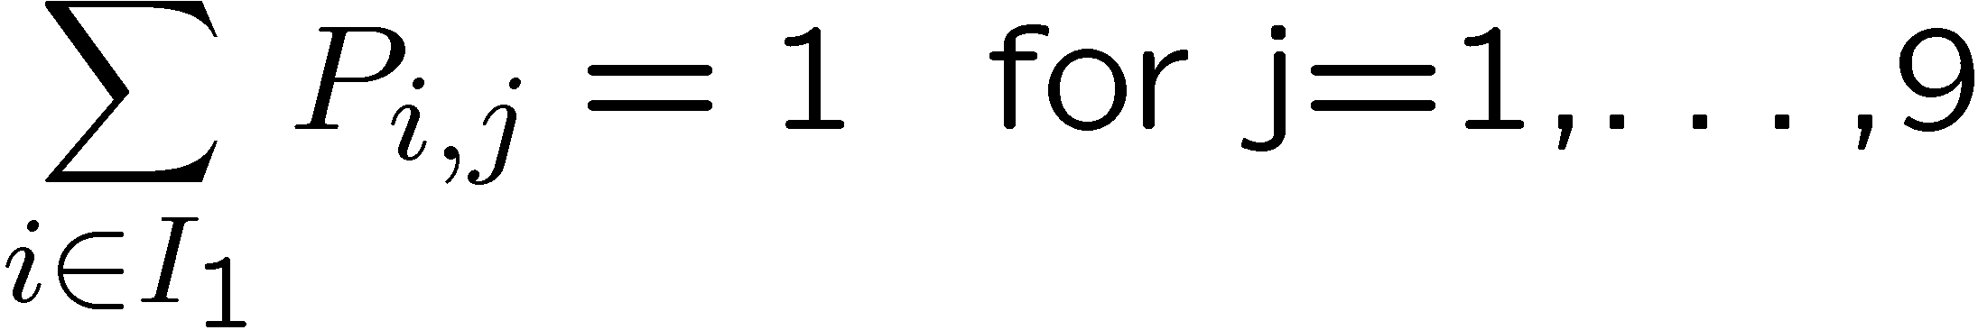
Constraints
Each column must contain one of each digit
1 | 10 | 19 | 28 | 37 | 46 | 55 | 64 | 73
2 | 11 | 20 | 29 | 38 | 47 | 56 | 65 | 74
3 | 12 | 21 | 30 | 39 | 48 | 57 | 66 | 75
4 | 13 | 22 | 31 | 40 | 49 | 58 | 67 | 76
5 | 14 | 23 | 32 | 41 | 50 | 59 | 68 | 77
6 | 15 | 24 | 33 | 42 | 51 | 60 | 69 | 78
7 | 16 | 25 | 34 | 43 | 52 | 61 | 70 | 79
8 | 17 | 26 | 35 | 44 | 53 | 62 | 71 | 80
9 | 18 | 27 | 36 | 45 | 54 | 63 | 72 | 81
Imposes a linear constraint on P
Index set I₁ = {1,2,3,4,…,9}
Constraint
Column constraints

Slide 13
Constrains as double-stochastic matrices
9 Values
1
2 …
9
1
2
1 | 10 | 19 | 28 | 37 | 46 | 55 | 64 | 73
2 | 11 | 20 | 29 | 38 | 47 | 56 | 65 | 74
3 | 12 | 21 | 30 | 39 | 48 | 57 | 66 | 75
4 | 13 | 22 | 31 | 40 | 49 | 58 | 67 | 76
5 | 14 | 23 | 32 | 41 | 50 | 59 | 68 | 77
6 | 15 | 24 | 33 | 42 | 51 | 60 | 69 | 78
7 | 16 | 25 | 34 | 43 | 52 | 61 | 70 | 79
8 | 17 | 26 | 35 | 44 | 53 | 62 | 71 | 80
9 | 18 | 27 | 36 | 45 | 54 | 63 | 72 | 81

9
P
81 Cells
Constraint implies the corresponding submatrix of P must be doubly stochastic

Slide 14
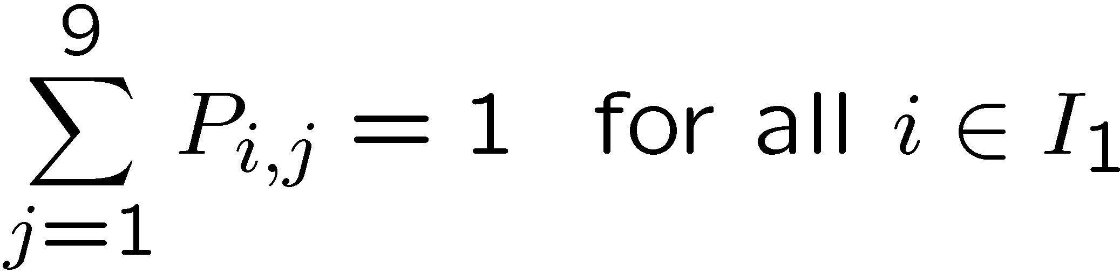
Burnashev-Zigangirov (BZ) Algorithm ‘73
For the each column to have one of each digit
Row constraint
Column constraint
➔ 9-by-9 doubly stochastic submatrix of P
There are a total of 27 “natural” constraints
  9 rows
  9 columns
  9 3-by-3 blocks
in addition to the given clues
Notes:
What if b ->0 ???

Slide 15
Decoding Sudoku
Each natural constraint defines a convex subset C₁, C₂, …, C₂₇ of 81-by-9 probability matrices with 9-by-9 doubly stochastic submatrices
Suggests the following algorithm:
Initialize P based on clues
Repeat
for m=1,2,...,27
Project current guess onto C_{m} via Sinkhorn
Balancing
end
Until convergence
Set cell i equal to most likely value
T.K. Moon and J.H. Gunther, “Multiple Constraint Satisfaction by Belief Propagation: An Example Using Sudoku,”
in Proc. IEEE Mountain Workshop on Adaptive and Learning Systems (SMCals), 2006.
T.K. Moon et al., “Sinkhorn Solves Sudoku,” preprint, 2006.

Slide 16
Relaxation of the space of Solutions
By relaxing the space of possible solutions (now there might be solutions that are not zero-one matrices) we made the problem much more tractable
It is possible to show the algorithm converges…
… but to the right solution?
Most of the times the algorithm converges to the unique solution, but not always…

Slide 17
Conclusions
Many interesting applications where we have a positive matrix and want a “close” doubly stochastic
Sinkhorn balancing gives us the closest fit:
- Minimizing KL distance to set of doubly stochastic matrices
- Alternate Projection onto convex sets
More interesting applications in the future?
  - LDPC decoding (TK Moon)
  - Web page ranking (P Knight)
  …
Other ways to relax the problem – with connections with l₀ vs. l₁ regularization…

